Slide 1
Geometric graphs

Slide 2
Outline
What is a geometric graph?
Motivation for geometric graphs
Constructing a geometric graph
Geometric symmetry
Molecular dynamics as a templar
Invariant Geometric GNNs
Equivariant Geometric GNNs

Slide 3
What is a geometric graph?

Slide 4
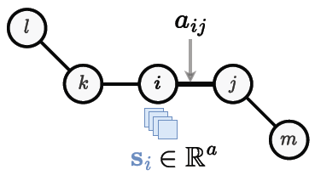
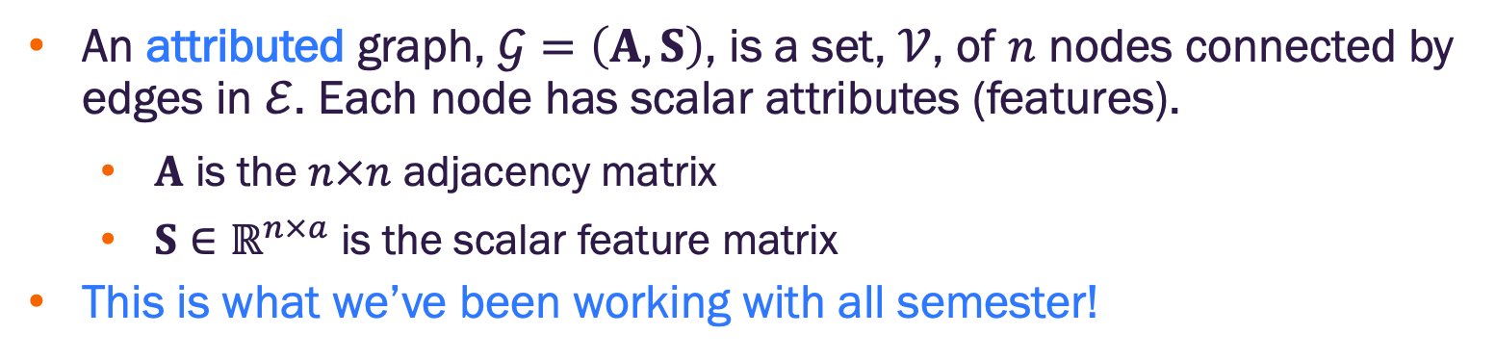
Attributed graph
An attributed graph, $𝒢=\left(A,S\right)$, is a set, $𝒱$, of $n$ nodes connected by edges in $ℰ$. Each node has scalar attributes (features).
$A$ is the $n×n$ adjacency matrix
$S∈ℝ^{n×a}$ is the scalar feature matrix
This is what we’ve been working with all semester!
Figure credit: Duval, et al. https://arxiv.org/abs/2312.07511

Slide 5
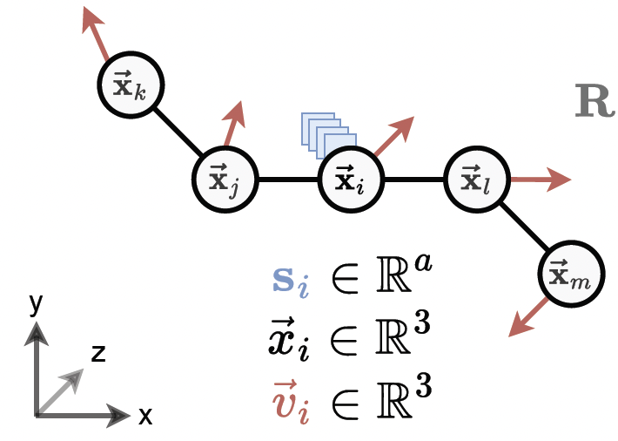
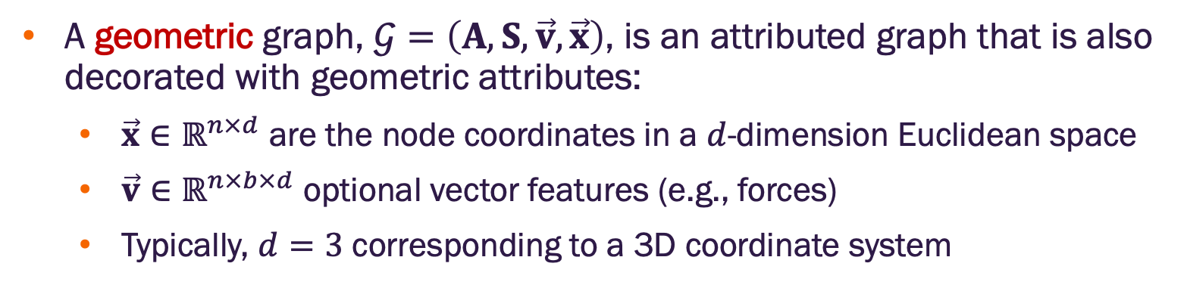
Geometric graph
A geometric graph, $𝒢=\left(A,S,\vec{v},\vec{x}\right)$, is an attributed graph that is also decorated with geometric attributes:
$\vec{x}∈ℝ^{n×d}$ are the node coordinates in a $d$-dimension Euclidean space
$\vec{v}∈ℝ^{n×b×d}$ optional vector features (e.g., forces)
Typically, $d=3$ corresponding to a 3D coordinate system
Figure credit: Duval, et al. https://arxiv.org/abs/2312.07511

Slide 6
Motivation for geometric graphs

Slide 7
Why do we need geometric graphs?
We often know geometric attributes (position, velocity, forces) of objects in a physical system (e.g., molecules)
We would like to include these in a GNN model
Why not just add these as scalar features?
Geometric properties are typically invariant or equivariant under known transformations e.g., translation)
Treating them as standard node features may not retain their physical meaning and transformation semantics

Slide 8
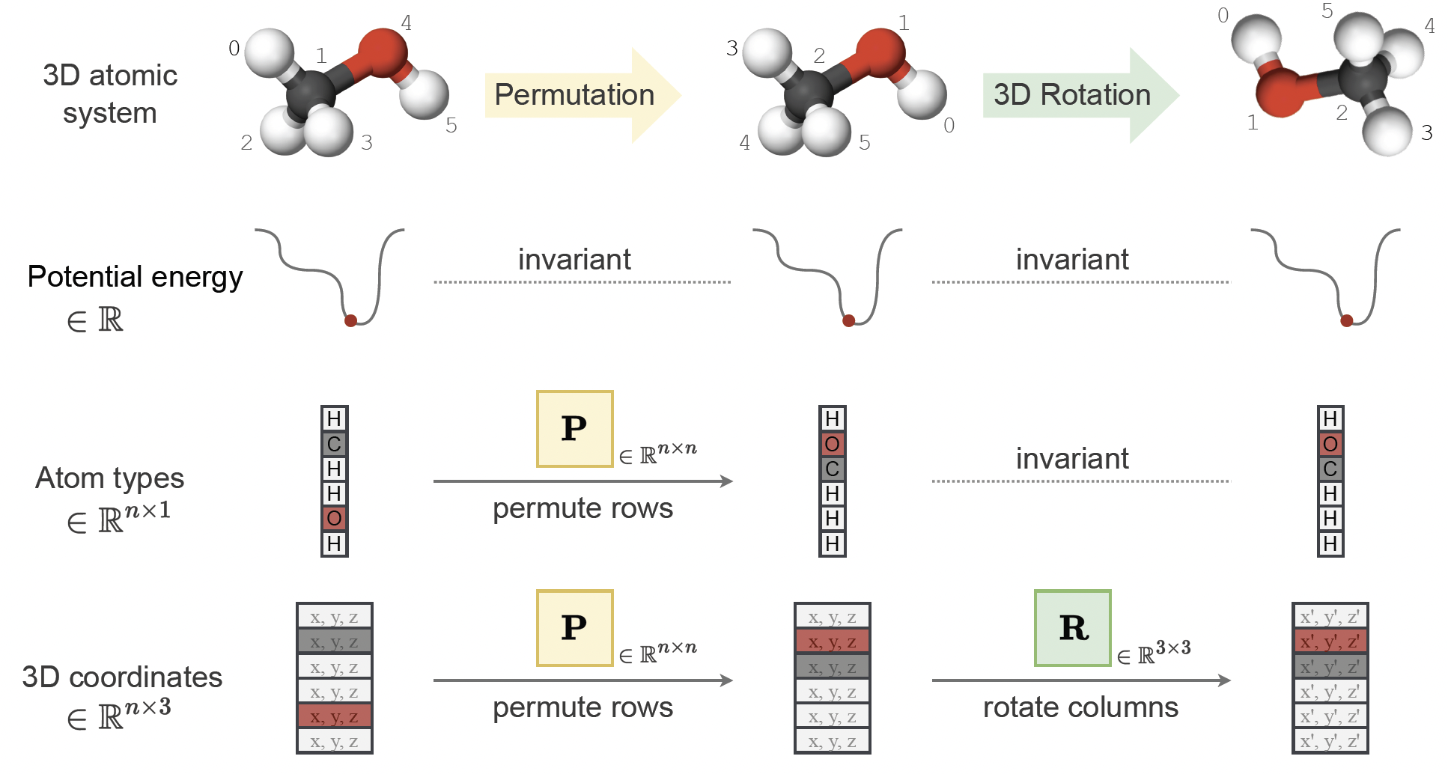
Why do we need geometric graphs?
Geometric properties are typically invariant or equivariant under known transformations e.g., translation)
Figure credit: Duval, et al. https://arxiv.org/abs/2312.07511

Slide 9
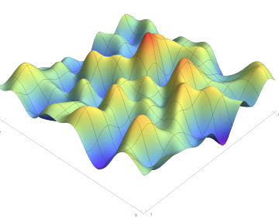
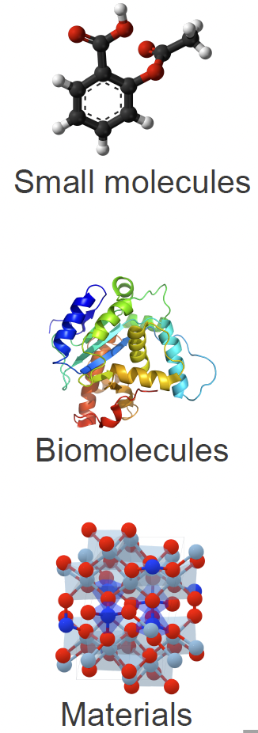
Why do we need geometric graphs?
Predicting properties via supervised learning
Predictions
Ligand binding affinity
Solubility
Toxicity
Stability
…
Geometric GNN
Figure credit: Duval, et al. https://arxiv.org/abs/2312.07511

Slide 10
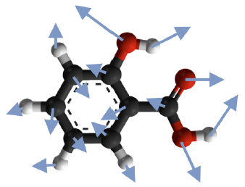
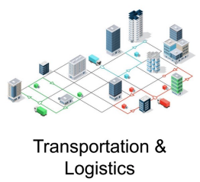
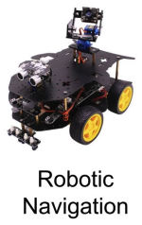
Why do we need geometric graphs?
Modeling system dynamics via supervised learning
Current
State
Next
State
System evolution
Is the system stable?
What conditions lead to system failure?
Geometric GNN
Figure credit: Duval, et al. https://arxiv.org/abs/2312.07511

Slide 11
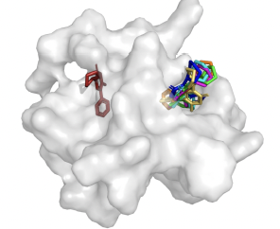
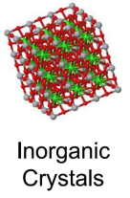
Why do we need geometric graphs?
Discovery via generative modeling
Novel graphs
Promising drug candidates
New materials
Geometric GNN
Figure credit: Duval, et al. https://arxiv.org/abs/2312.07511

Slide 12
Constructing geometric graphs

Slide 13
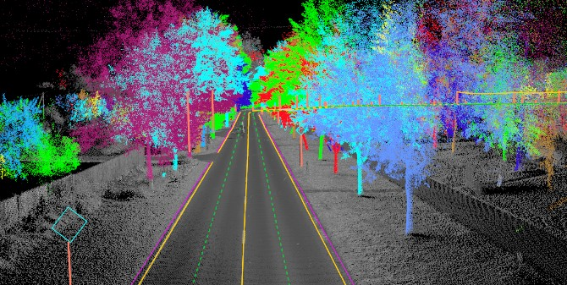
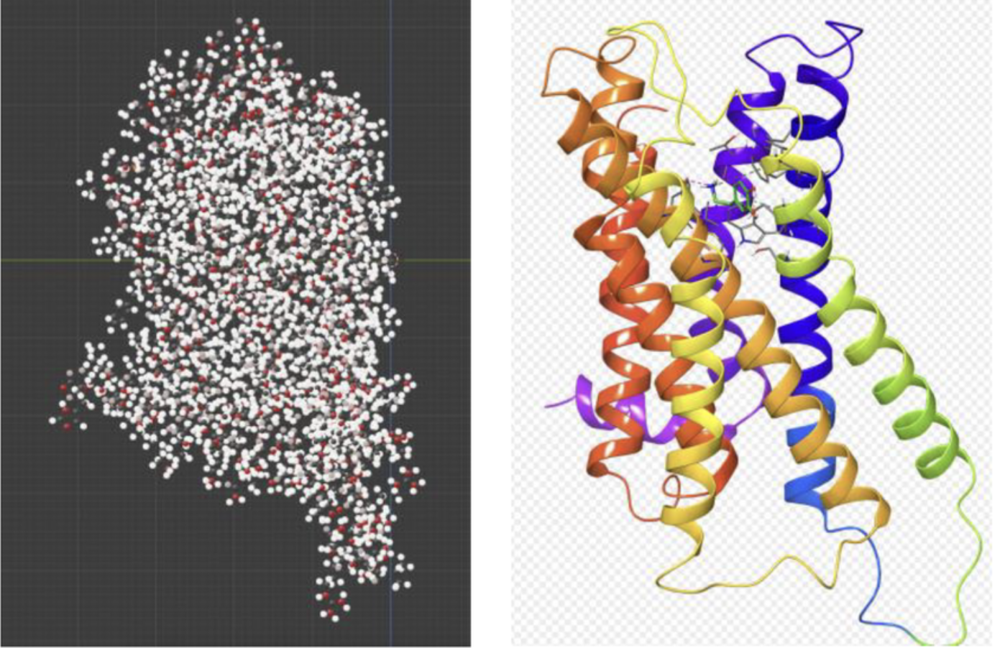
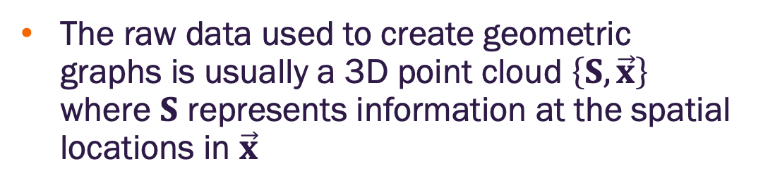
Point clouds
The raw data used to create geometric graphs is usually a 3D point cloud $\left\{S, \vec{x}\right\}$ where $S$ represents information at the spatial locations in $\vec{x}$

Slide 14
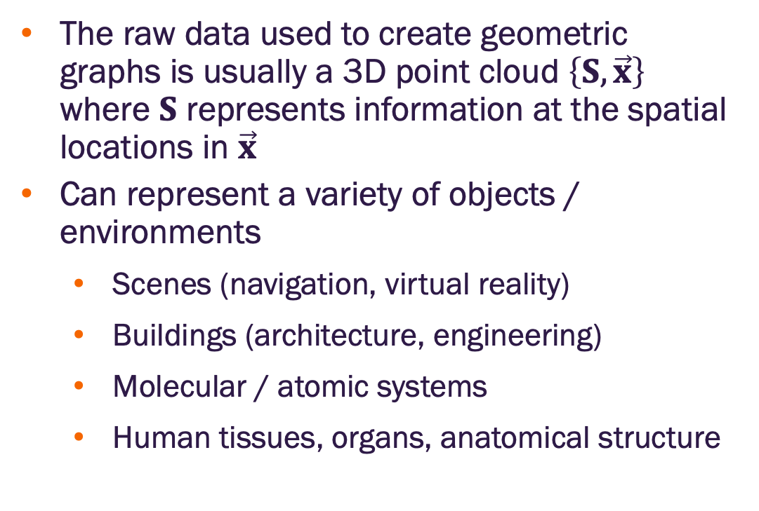
Point clouds
The raw data used to create geometric graphs is usually a 3D point cloud $\left\{S, \vec{x}\right\}$ where $S$ represents information at the spatial locations in $\vec{x}$
Can represent a variety of objects / environments
Scenes (navigation, virtual reality)
Buildings (architecture, engineering)
Molecular / atomic systems
Human tissues, organs, anatomical structure
How do we convert these to graphs?

Slide 15
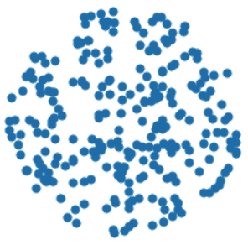
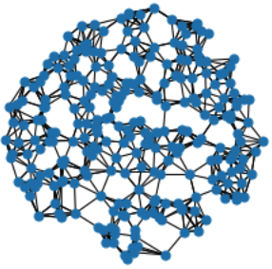
Point clouds to graphs
How should we convert point clouds to graphs? Specifically, which points should be connected via edges?

Slide 16
Point clouds to graphs via a complete graph
Complete graph – every point is connected to every other point
Edges weighted by distance between points
Most comprehensive representation of the system
Computationally demanding for larger (more nodes) systems

Slide 17
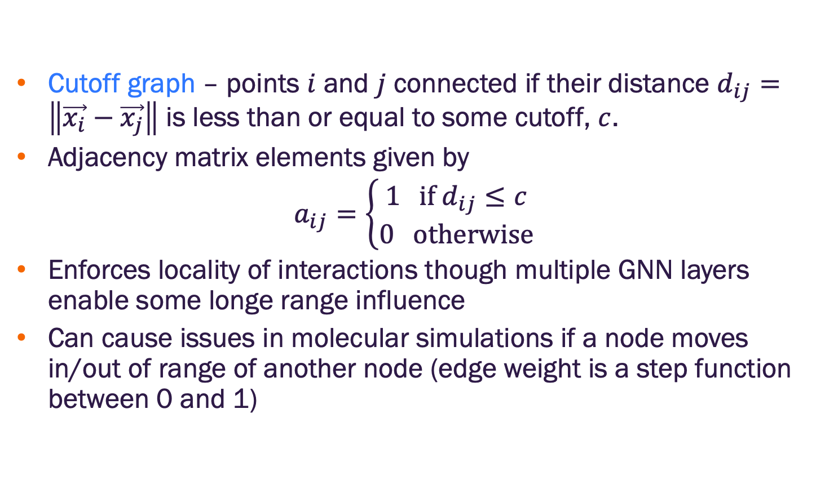
Point clouds to graphs via a cutoff graph
Cutoff graph – points $i$ and $j$ connected if their distance $d_{ij}=\left\|\vec{x_{i}}−\vec{x_{j}}\right\|$ is less than or equal to some cutoff, $c$.
Adjacency matrix elements given by
$a_{ij}=\left\{\begin{aligned}1 if{ d}_{ij}≤c \\ 0 otherwise\end{aligned}\right.$
Enforces locality of interactions though multiple GNN layers enable some longe range influence
Can cause issues in molecular simulations if a node moves in/out of range of another node (edge weight is a step function between 0 and 1)

Slide 18
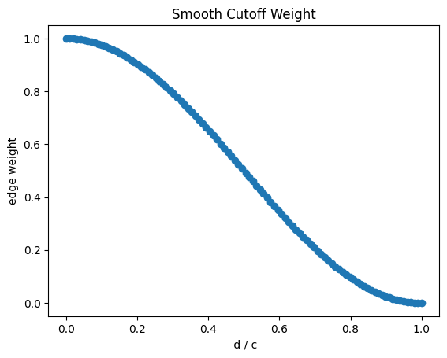
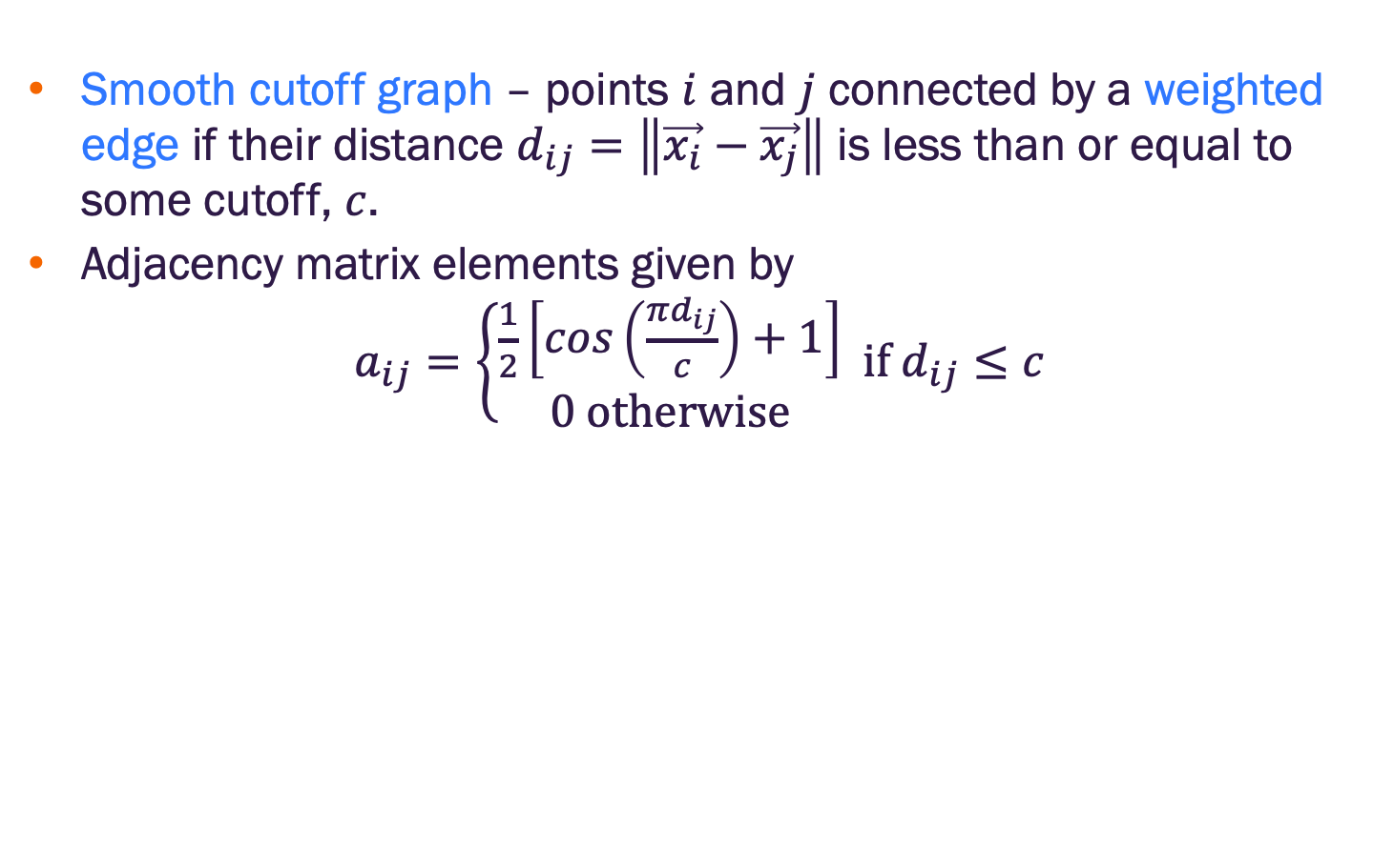
Point clouds to graphs via a smooth cutoff graph
Smooth cutoff graph – points $i$ and $j$ connected by a weighted edge if their distance $d_{ij}=\left\|\vec{x_{i}}−\vec{x_{j}}\right\|$ is less than or equal to some cutoff, $c$.
Adjacency matrix elements given by
$a_{ij}=\left\{\begin{aligned}\frac{1}{2}\left[cos\left(\frac{πd_{ij}}{c}\right)+1\right] \\ 0 otherwise\end{aligned} if{ d}_{ij}≤c\right.$

Slide 19
Point clouds to graphs
Which method to use typically requires some domain knowledge
There are domain specific methods (e.g., in crystalline structures periodic boundary conditions are added)

Slide 20
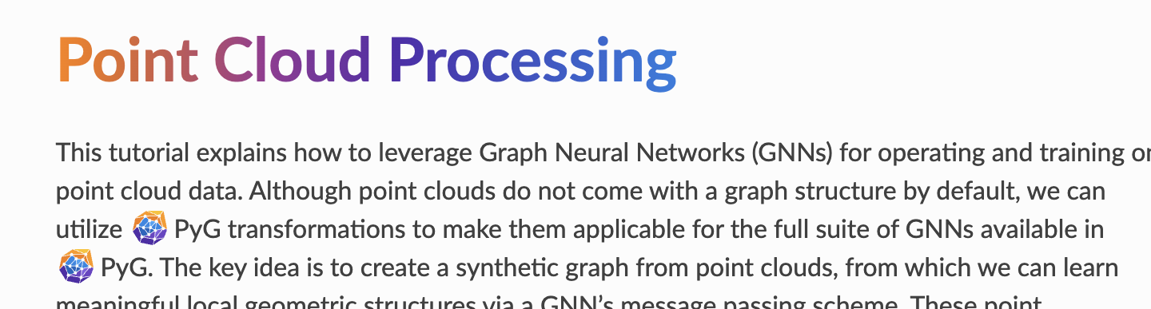
Point cloud processing with PyTorch Geometric
PyG includes
Point cloud datasets
Transformations to convert point clouds to graphs (somewhat limited)
https://pytorch-geometric.readthedocs.io/en/stable/tutorial/point_cloud.html

Slide 21
Other data pre-processing steps
Standard data preparation
feature normalization
centering to the origin (subtracting the point cloud centroid)
Augmentation
Euclidean transformations on training samples
Corrupted samples (e.g., noise added to position information)

Slide 22
Geometric symmetry

Slide 23
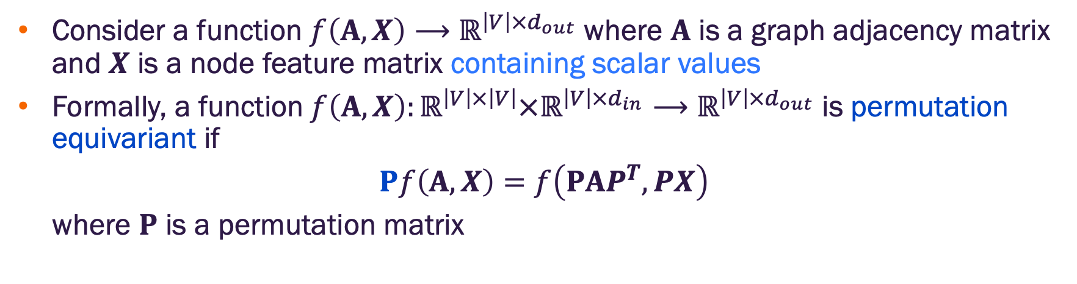
Permutation equivariance for node labeling
Consider a function $f\left(A,X\right)⟶ℝ^{\left|V\right|×d_{out}}$ where $A$ is a graph adjacency matrix and $X$ is a node feature matrix containing scalar values
Formally, a function$f\left(A,X\right):ℝ^{\left|V\right|×\left|V\right|}×ℝ^{\left|V\right|×d_{in}}⟶ℝ^{{\left|V\right|×d}_{out}}$ is permutation equivariant if
$$Pf\left(A,X\right)=f\left(PAP^{T},PX\right)$$
where $P$ is a permutation matrix
We will need a more general understanding of equivariance for geometric graphs. Let’s see why.
https://ml4g.masinolab.com/topics/gnns/gnn-permutation-demo.html

Slide 24
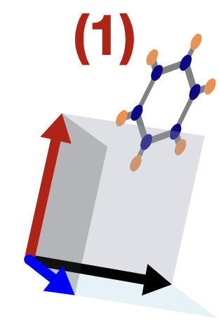

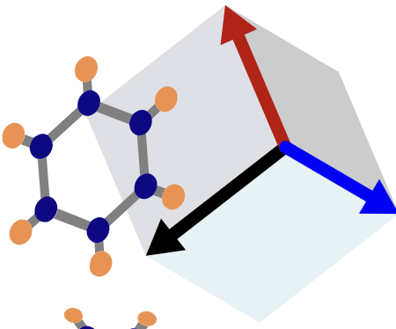
Geometric symmetry groups
We want to use geometric graphs to represent objects in a coordinate system
Different coordinate systems can describe the same geometry
We can mathematically describe the transformations between coordinate systems with symmetries of Euclidean spaces
rotations, reflections, translations
Image credit: Jure Leskovec, http://cs224w.stanford.edu

Slide 25
Geometric symmetry of inputs
Different coordinate systems can describe the same geometry
Standard GNNs will produce unpredictably different answers given tensor inputs (e.g., position vectors) from different coordinate systems
This is not just node relabeling, it’s a change to the input feature values
We want to design geometric GNNs that are symmetry aware
Image credit: Jure Leskovec, http://cs224w.stanford.edu

Slide 26
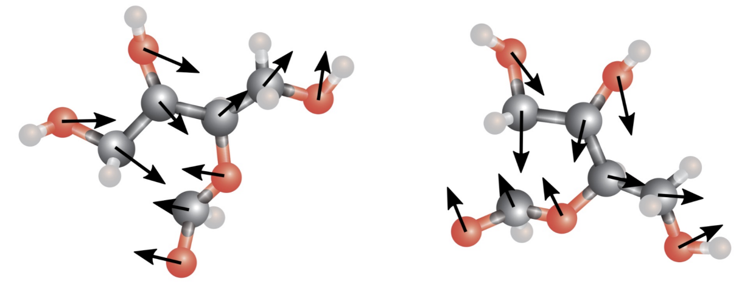
Geometric symmetry of outputs
In standard GNNs, we need to ensure the encoder is equivariant to node relabeling
Node embedding updates are invariant
Graph embedding matrix (i.e., matrix of node embeddings) is equivariant
For a geometric graph, that outputs tensors (e.g., force prediction), the decoder also needs to be equivariant to coordinate system changes
Example: predicted molecular forces should be equivariant to rotations
Image credit: Jure Leskovec, http://cs224w.stanford.edu

Slide 27
Groups
A group is a collection of reversible operations that act on elements of spaces.

Slide 28
Groups
A group is a collection of reversible operations that act on elements of spaces.
An operation in a group is a concept that may have different realizations (implementations) in different spaces

Slide 29
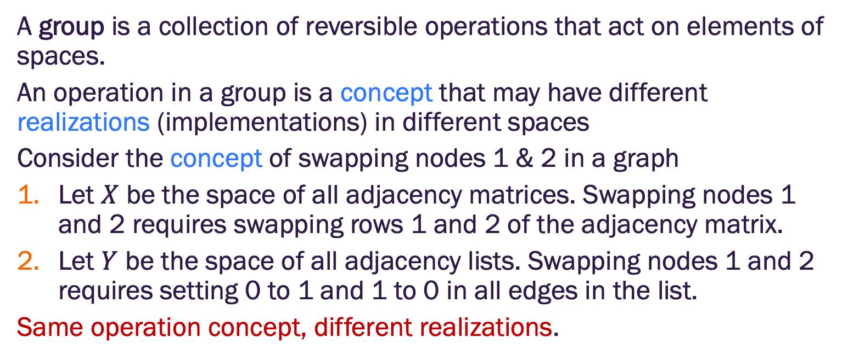
Groups
A group is a collection of reversible operations that act on elements of spaces.
An operation in a group is a concept that may have different realizations (implementations) in different spaces
Consider the concept of swapping nodes 1 & 2 in a graph
Let $X$ be the space of all adjacency matrices. Swapping nodes 1 and 2 requires swapping rows 1 and 2 of the adjacency matrix.
Let $Y$ be the space of all adjacency lists. Swapping nodes 1 and 2 requires setting 0 to 1 and 1 to 0 in all edges in the list.
Same operation concept, different realizations.

Slide 30
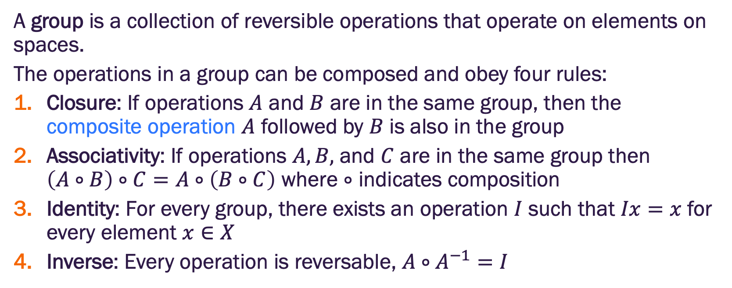
Groups
A group is a collection of reversible operations that operate on elements on spaces.
The operations in a group can be composed and obey four rules:
Closure: If operations $A$ and $B$ are in the same group, then the composite operation $A$ followed by $B$ is also in the group
Associativity: If operations $A, B,$ and $C$ are in the same group then $\left(A∘B\right)∘C=A∘\left(B∘C\right)$ where $∘$ indicates composition
Identity: For every group, there exists an operation $I$ such that $Ix=x$ for every element $x∈X$
Inverse: Every operation is reversable, $A∘A^{−1}=I$

Slide 31
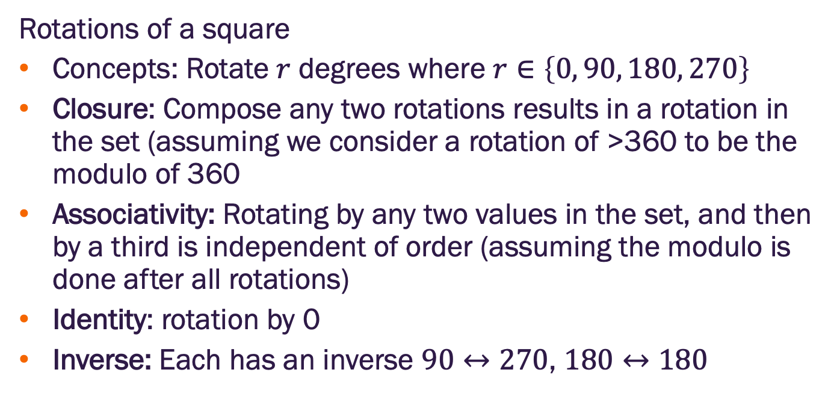
Group example
Rotations of a square
Concepts: Rotate $r$ degrees where $r∈\left\{0, 90, 180, 270\right\}$
Closure: Compose any two rotations results in a rotation in the set (assuming we consider a rotation of >360 to be the modulo of 360
Associativity: Rotating by any two values in the set, and then by a third is independent of order (assuming the modulo is done after all rotations)
Identity: rotation by 0
Inverse: Each has an inverse $90↔270$, $180↔180$

Slide 32
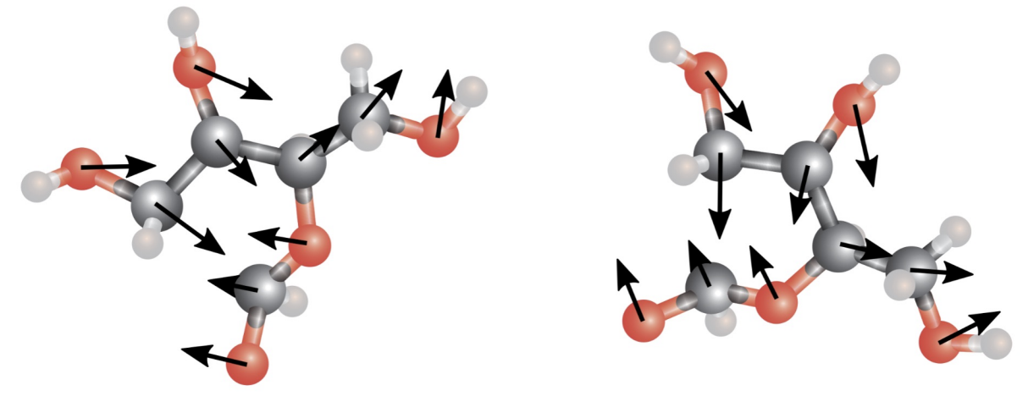
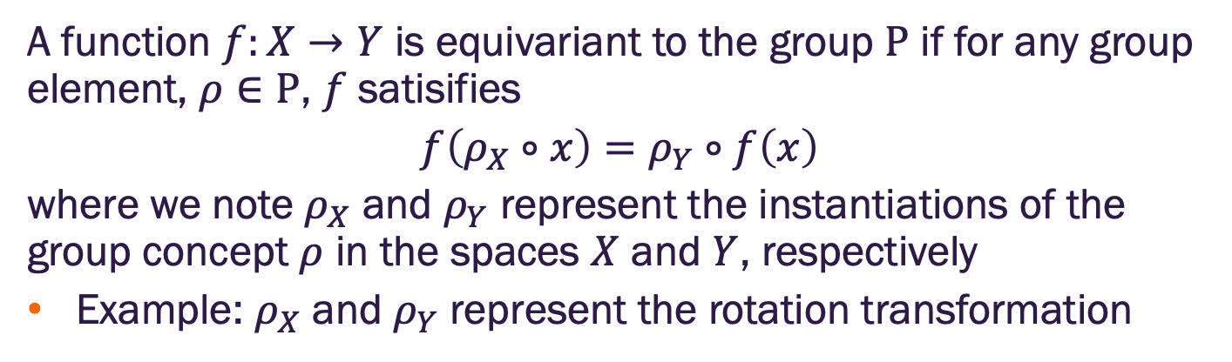
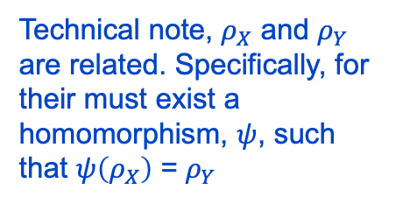
Equivariance on groups
A function $f:X→Y$ is equivariant to the group $Ρ$ if for any group element, $ρ∈Ρ$, $f$ satisifies
$$f\left(ρ_{X}∘x\right)=ρ_{Y}∘f\left(x\right)$$
where we note $ρ_{X}$ and $ρ_{Y}$ represent the instantiations of the group concept $ρ$ in the spaces $X$ and $Y$, respectively
Example: $ρ_{X}$ and $ρ_{Y}$ represent the rotation transformation
Technical note, $ρ_{X}$ and $ρ_{Y}$ are related. Specifically, for their must exist a homomorphism, $ψ$, such that $ψ\left(ρ_{X}\right)$ = $ρ_{Y}$
Image credit: Jure Leskovec, http://cs224w.stanford.edu

Slide 33
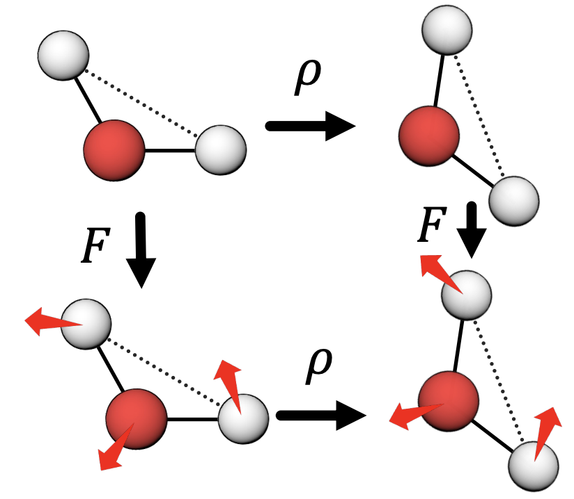
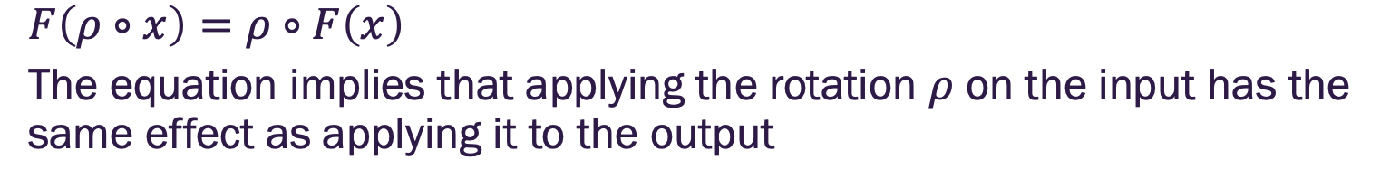
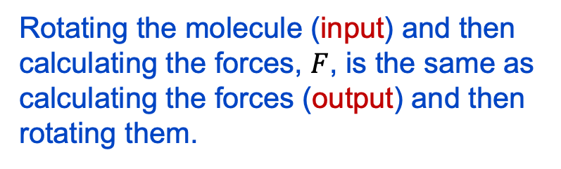
3D rotation equivariance
$$F\left(ρ∘x\right)=ρ∘F\left(x\right)$$
The equation implies that applying the rotation $ρ$ on the input has the same effect as applying it to the output
Rotating the molecule (input) and then calculating the forces, $F$, is the same as calculating the forces (output) and then rotating them.
Image credit: Jure Leskovec, http://cs224w.stanford.edu

Slide 34

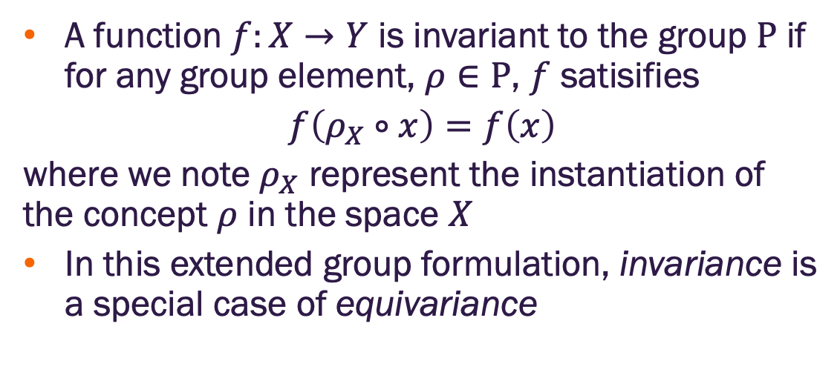
Invariance
A function $f:X→Y$ is invariant to the group $Ρ$ if for any group element, $ρ∈Ρ$, $f$ satisifies
$$f\left(ρ_{X}∘x\right)=f\left(x\right)$$
where we note $ρ_{X}$ represent the instantiation of the concept $ρ$ in the space $X$
In this extended group formulation, invariance is a special case of equivariance
Output label: dog
After rotation, translation
Stil a dog

Slide 35
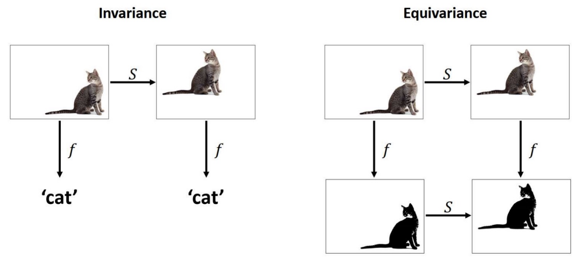
Invariance & equivariance on images
Consider rotations, reflections and translations in the image domain
Classification: label output (scalar) should be invariant
Segmentation: pixel coordinates (tensor) should be equivariant
Image credit: https://www.doc.ic.ac.uk/~bkainz/teaching/DL/notes/equivariance.pdf

Slide 36
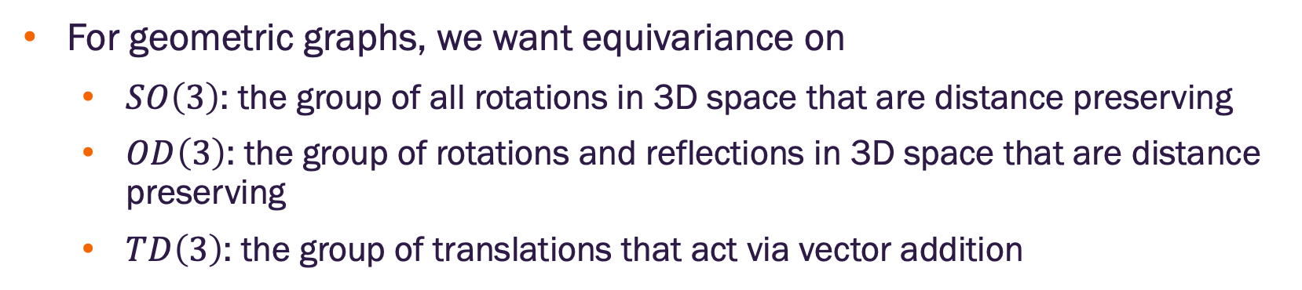
Invariance and equivariance in Euclidean space
For geometric graphs, we want equivariance on
$SO\left(3\right)$: the group of all rotations in 3D space that are distance preserving
$OD\left(3\right)$: the group of rotations and reflections in 3D space that are distance preserving
$TD\left(3\right)$: the group of translations that act via vector addition

Slide 37
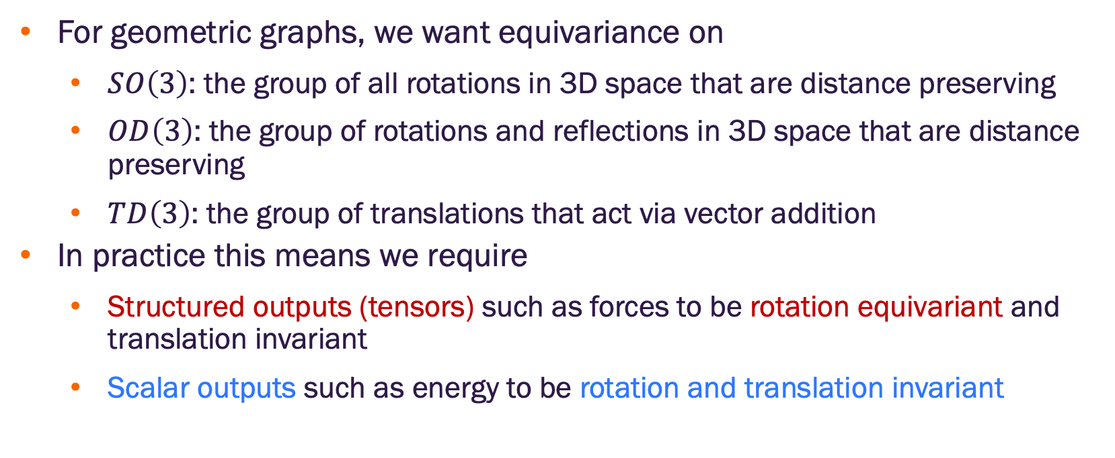
Invariance and equivariance in Euclidean space
For geometric graphs, we want equivariance on
$SO\left(3\right)$: the group of all rotations in 3D space that are distance preserving
$OD\left(3\right)$: the group of rotations and reflections in 3D space that are distance preserving
$TD\left(3\right)$: the group of translations that act via vector addition
In practice this means we require
Structured outputs (tensors) such as forces to be rotation equivariant and translation invariant
Scalar outputs such as energy to be rotation and translation invariant

Slide 38
Molecular dynamics as a templar

Slide 39
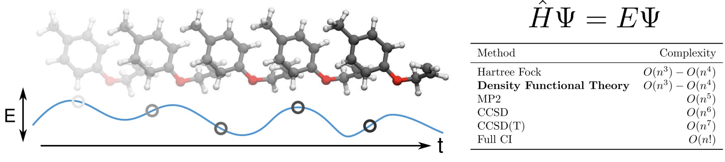
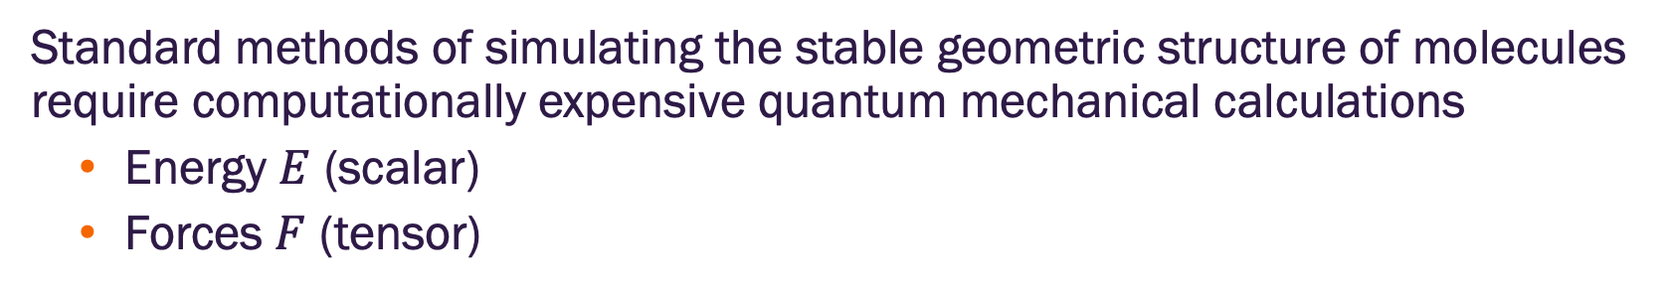
Molecular dynamics simulations
Standard methods of simulating the stable geometric structure of molecules require computationally expensive quantum mechanical calculations
Energy $E$ (scalar)
Forces $F$ (tensor)
Image credit: Jure Leskovec, http://cs224w.stanford.edu

Slide 40
Molecular dynamics simulations
Can be used for various applications
Protein folding prediction
Materials property prediction
Self-assembly of nanostructures
Image credit: Jure Leskovec, http://cs224w.stanford.edu

Slide 41
Molecular dynamics simulations
Geometric graphs to reduce computational costs & increase accuracy?
Inputs: molecular graphs with scalar atom types and tensor positions
Outputs:
Molecular total energy (scalar, invariant)
Forces acting on each atom (tensor, equivariant)
Image credit: Jure Leskovec, http://cs224w.stanford.edu

Slide 42
Invariant geometric GNNs

Slide 43
Invariant geometric GNNs
Key idea of invariant geometric GNNs is to convert geometric input tensors to informative scalar quantities such as distances and angles
The input scalar quantities are invariant to Euclidean transformations
Intermediate node representations and output predictions are guaranteed to be invariant
Limitation – all such approaches rely on a set of precomputed local invariants (feature engineering)

Slide 44
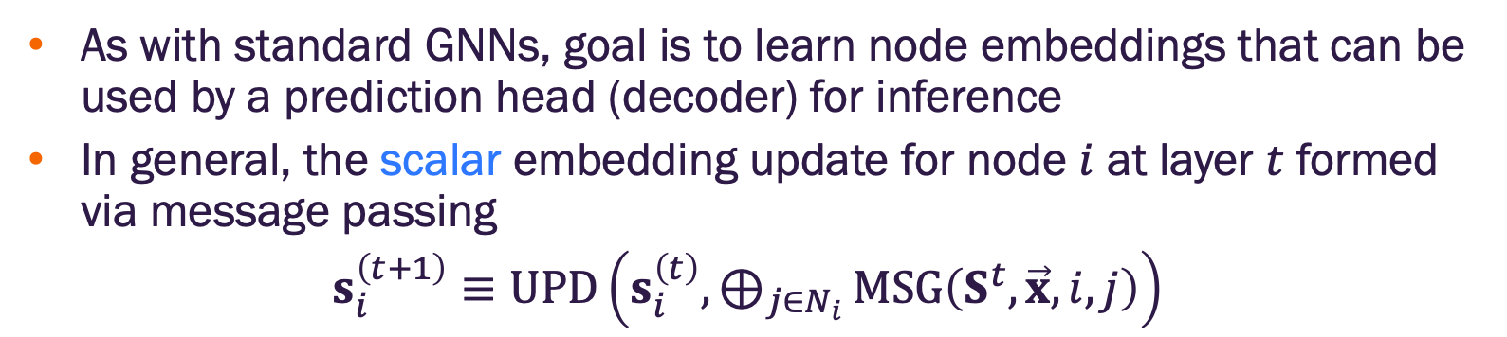
Invariant geometric GNNs
As with standard GNNs, goal is to learn node embeddings that can be used by a prediction head (decoder) for inference
In general, the scalar embedding update for node $i$ at layer $t$ formed via message passing
$s_{i}^{\left(t+1\right)}≡UPD\left(s_{i}^{\left(t\right)}, \underset{j∈N_{i}}{⊕}{MSG\left(S^{t},\vec{x}, i, j\right)}\right)$
learnable functions
aggregation

Slide 45
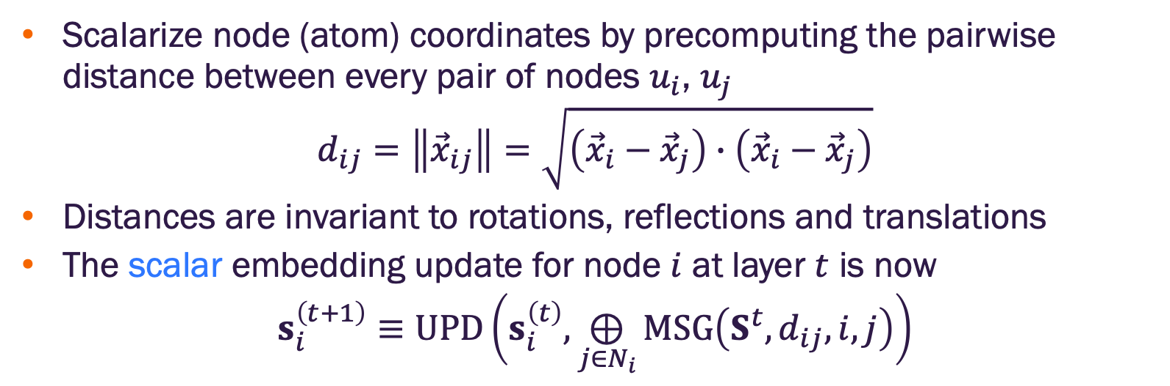
Distance-based invariant geometric GNNs
Scalarize node (atom) coordinates by precomputing the pairwise distance between every pair of nodes $u_{i}$, $u_{j}$
$$d_{ij}=\left\|{\vec{x}}_{ij}\right\|=\sqrt{\left({\vec{x}}_{i}−{\vec{x}}_{j}\right)∙\left({\vec{x}}_{i}−{\vec{x}}_{j}\right)}$$
Distances are invariant to rotations, reflections and translations
The scalar embedding update for node $i$ at layer $t$ is now
$$s_{i}^{\left(t+1\right)}≡UPD\left(s_{i}^{\left(t\right)}, \underset{j∈N_{i}}{⊕}{MSG\left(S^{t},d_{ij}, i, j\right)}\right)$$

Slide 46
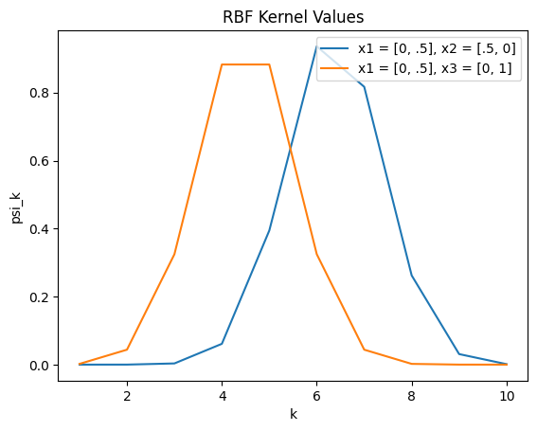
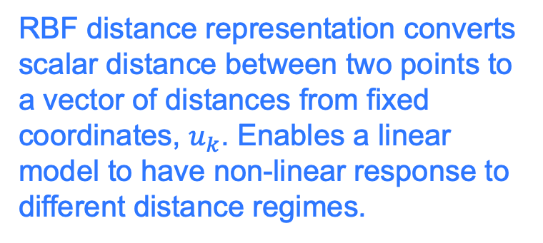
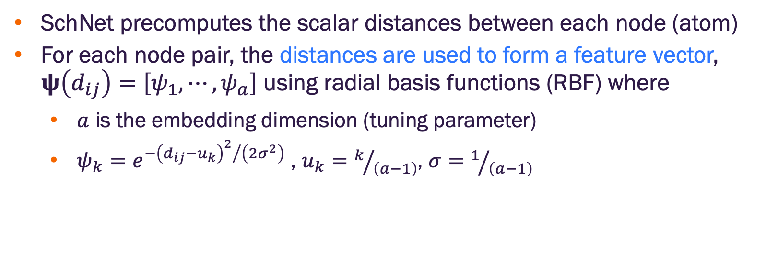
SchNet distance-based invariant GNN
SchNet precomputes the scalar distances between each node (atom)
For each node pair, the distances are used to form a feature vector, $ψ\left(d_{ij}\right)=\left[ψ_{1}, ⋯,ψ_{a}\right]$ using radial basis functions (RBF) where
$a$ is the embedding dimension (tuning parameter)
$ψ_{k}=e^{−{{\left(d_{ij}−u_{k}\right)}^{2}}/{\left(2σ^{2}\right)}}$ , $u_{k}=k/{\left(a−1\right)}$, $σ=1/{\left(a−1\right)}$
RBF distance representation converts scalar distance between two points to a vector of distances from fixed coordinates, $u_{k}$. Enables a linear model to have non-linear response to different distance regimes.

Slide 47
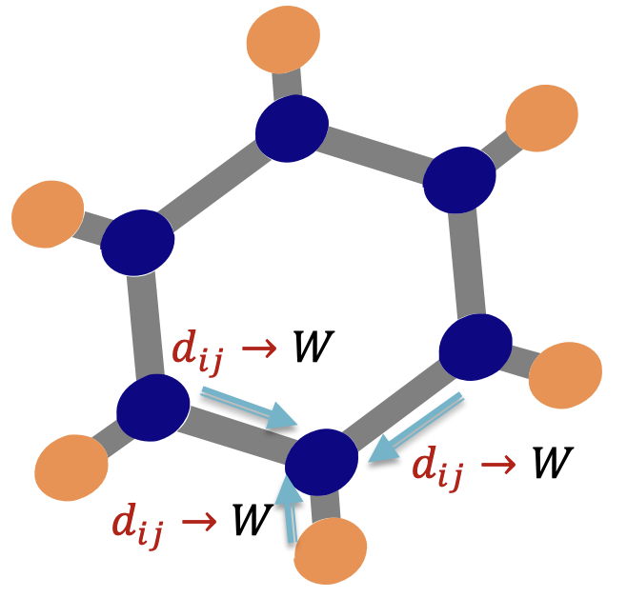
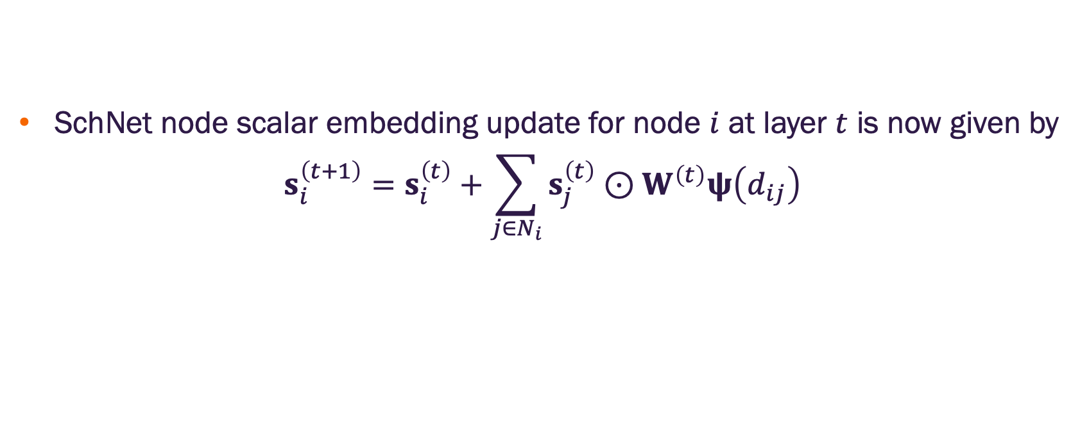
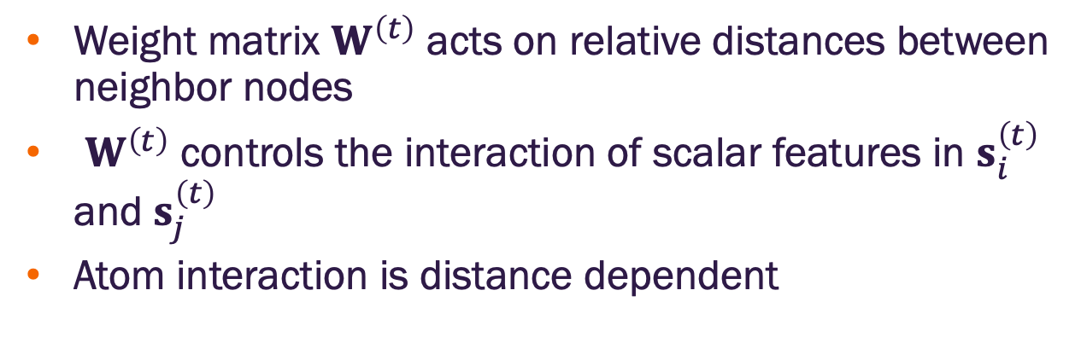
SchNet distance-based invariant GNN
SchNet node scalar embedding update for node $i$ at layer $t$ is now given by
$$s_{i}^{\left(t+1\right)}=s_{i}^{\left(t\right)}+\sum_{j∈N_{i}}{s_{j}^{\left(t\right)}⊙W^{\left(t\right)}ψ\left(d_{ij}\right)}$$
learnable matrix
Weight matrix $W^{\left(t\right)}$ acts on relative distances between neighbor nodes
$W^{\left(t\right)}$ controls the interaction of scalar features in $s_{i}^{\left(t\right)}$ and $s_{j}^{\left(t\right)}$
Atom interaction is distance dependent
Image credit: Jure Leskovec, http://cs224w.stanford.edu

Slide 48
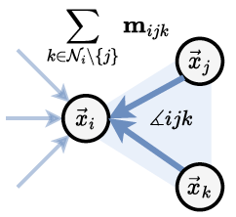


DimeNet distance and angle-based invariant GNNs
Total molecular potential energy is the sum of four parts
$$E=E_{bonds}+E_{angle}+E_{torsion}+E_{non−bonded}$$
SchNet only considers atom types and pairwise distances
DimeNet
Considers bond angles and distance between node (atom) triplets $\left(i, j, k\right)$
As with SchNet, uses basis functions to form distance and angle features
Distances between each $\left(i, j\right)$ and $\left(i, k\right)$ represented by Spherical Bessel Functions (SBF)
Angles formed by the triplet represented by Spherical Harmonics
Figure credit: Duval, et al. https://arxiv.org/abs/2312.07511

Slide 49
Limitation of invariant geometric GNNs
All invariant geometric GNNs rely on a set of precomputed local invariants
In other words, the raw geometric relations are converted to informative values
This is feature engineering
Can a model that acts directly on the geometric tensors be more expressive?

Slide 50
Equivariant geometric GNNs

Slide 51



PaiNN Equivariant GNN
Includes scalar and tensor (vector) features and messages
Scalar messages are formed by applying a learnable weight matrix $W$ to relative distances represented by RBF (as in SchNet)
$$m_{i}^{\left(t\right)}=s_{i}^{\left(t\right)}+\sum_{j∈N_{i}}{s_{j}^{\left(t\right)}⊙W_{1}^{\left(t\right)}ψ\left(d_{ij}\right)}$$
Tensor messages are formed by scaling tensor features by weights determined by the relative distances and input scalar features
$${\vec{m}}_{i}^{\left(t\right)}={\vec{v}}_{i}^{\left(t\right)}+\sum_{j∈N_{i}}{s_{j}^{\left(t\right)}⊙W_{2}^{\left(t\right)}ψ\left(d_{ij}\right)⊙{\vec{v}}_{j}^{\left(t\right)}}+\sum_{j∈N_{i}}{s_{j}^{\left(t\right)}⊙W_{3}^{\left(t\right)}ψ\left(d_{ij}\right)⊙{\vec{x}}_{ij}^{\left(t\right)}}$$
summation over vector scaling is equivariant to input changes
Image credit: Jure Leskovec, http://cs224w.stanford.edu

Slide 52


PaiNN Equivariant GNN
Node embedding updates performed via residual connections
Node scalar embedding updates
$$∆s_{i}^{\left(t\right)}=m_{i}^{\left(t\right)}=s_{i}^{\left(t\right)}+\sum_{j∈N_{i}}{s_{j}^{\left(t\right)}⊙W_{1}^{\left(t\right)}ψ\left(d_{ij}\right)}$$
$$s_{i}^{\left(t+1\right)}=s_{i}^{\left(t\right)}+∆s_{i}^{\left(t\right)}$$
Node tensor embedding updates
$$∆{\vec{v}}_{i}^{\left(t\right)}={\vec{m}}_{i}^{\left(t\right)}={\vec{v}}_{i}^{\left(t\right)}+\sum_{j∈N_{i}}{s_{j}^{\left(t\right)}⊙W_{2}^{\left(t\right)}ψ\left(d_{ij}\right)⊙{\vec{v}}_{j}^{\left(t\right)}}+\sum_{j∈N_{i}}{s_{j}^{\left(t\right)}⊙W_{3}^{\left(t\right)}ψ\left(d_{ij}\right)⊙{\vec{x}}_{ij}^{\left(t\right)}}$$
$${\vec{v}}_{i}^{\left(t+1\right)}={\vec{v}}_{i}^{\left(t\right)}+∆{\vec{v}}_{i}^{\left(t\right)}$$
Image credit: Jure Leskovec, http://cs224w.stanford.edu

Slide 53

PaiNN Equivariant GNN
By stacking multiple PaiNN layers
vector features after final layer are tensors equivariant to input coordinate changes
vector features can be used directly for force (tensor) prediction
Image credit: Jure Leskovec, http://cs224w.stanford.edu

Slide 54


